Slide 1
Boolean logic and its importance to computational thinking
Lecture Three
17th Feb 2022

Slide 2
Objective
Get to know about the history of Boolean Logic
To understand the relationship between computers and logic thinking
Understanding how simple logic “gates” work and how they combine into something useful

Slide 3
Introduction
Boolean logic, originally developed by George Boole in the mid-1800s
Allows quite a few unexpected things to be mapped into bits and bytes
George Boole was recognized as the father of modern information technology since he came up with an idea that was at the same time revolutionary and simple
Boole’s work certainly started modern logic off on the right road, but it certainly was not anything to do with the laws of thought
The fact of the matter is that even today, we have no clear idea what laws govern thought, and if we did, the whole subject of artificial intelligence would be a closed one

Slide 4
George Boole died at the age of 49 in 1846
His work might never have had an impact on computer science without somebody like Claude Shannon
70 years later he recognized the relevance for engineering of Boole’s symbolic logic
As a result, Boole’s thinking has become the practical foundation of digital circuit design and the theoretical grounding of the digital age

Slide 5
Boolean logic and how it works can be simply defined by thinking about, how a computer can do some logical things and tasks like playing chess, or spell-checking a document?
These are things that, just a few decades ago, only humans could do
Question: How can a “chip” made up of silicon and wires do something that seems like it requires human thought?
Computers and logic have an inseparable relationship
The first computers were conceived as automatic arithmetic engines, and while their creators were aware that logic had something to do with it all, they were not 100% clear as to the how or why
Even today, we tend to be over simplistic about logic, and its role in computation and understanding the world and George Boole the man who started it all off was a bit over the top on the subject

Slide 6
Boolean logic explained
You start off with the idea that some statement P is either true or false, it can’t be anything in between (this called the law of the excluded middle)
You can form other statements, which are true or false, by combining these initial statements together using the fundamental operators AND, OR, and NOT
The way that all this works more or less fits in with the way that we used these terms in English

Slide 7
For example, if P is true, then NOT(P) is false, so if “today is Thursday” is true, then “Not (today is Thursday)” is false
We often translate the logical expression into English as “today is Not Thursday,” and this makes it easier to see that it is false if today is indeed Thursday
This is the problem with this sort of discussion. It very quickly becomes convoluted and difficult to follow, and this is part of the power of Boolean logic
You can write down arguments clearly in symbolic form
The one thing about Boolean logic is that, once you get the hang of things, Boolean logic (or at least the parts you need in order to understand the operations of computers) becomes simple

Slide 8
Computers and Logic thinking
In logical statements, the concepts that are known and considered as true, are called premise, and it always has a true value
As soon as all premises are set up, they have to be analysed
Logical statements can differ by their strength
Deductive argument is usually the strongest form of argument
Inductive argument is the argument that is intended to be valid by the arguer to show guarantee of the truth

Slide 9
The biggest part of our reasoning is inductive, computer reasoning though works differently
The computer logic thinking is based on a binary system
The method that is used by computers is called Boolean logic
Boolean logic deals with the statements that have true or false values

Slide 10
Statements in Boolean logic
They are called propositions and have several properties
Has only one value at a time;
Has clear meaning;
Propositions can combine and result into complex propositions, called compound propositions
Several propositions can be combined using operators

Slide 11
Logical operators
AND (conjunction)
OR (disjunction)
NOT (negation)
IMPLIES (implication)
IF AND ONLY IF (biconditioning)

Slide 12
Operator AND connect propositions in a way that if all of them are true, then conclusion is also true
Boolean multiplication is equivalent to the AND operation
Operator OR connect propositions together so when at least one of them is true, the conclusion is also true
Boolean addition is equivalent to the OR operation
Operator NOT modifies the proposition into the opposite value

Slide 13
Operator IMPLIES shows the correlation between statements – if the first statement is true, then the second one should be also true
This operator though does not allow to analyse backwards from conclusion to statement
IF AND ONLY IF operator shows correlation between statement as well, and it can work in a backward direction – if the first statement is true, then second statement is true and vice versa

Slide 14
To make reasoning clear, computational thinking uses symbolic language
Using a lot of words is avoided and use of every proposition as a variable is employed
Operators on the other hand are replaced by a symbol
Symbolic logic gives every operator formal rules
The meaning of operator is specified mathematically
Logical statements are frequently used as the truth tables

Slide 15
Boolean Analysis of Circuits
Boolean Algebra provides us a concise way to express the operation of a logic circuit formed in a combination of logic gates
The output can be determined for various combinations of input values

Slide 16
Boolean Expression for a Logic Circuit
To derive the Boolean expression for a given logic circuit, begin at the right-most inputs and work toward the final output, writing the expression for each gate
X= A(B+CD)
Illustration

Slide 17
Constructing a Truth Table for a Logic Circuit
Once the Boolean expression for a given logic circuit has been determined, a truth table that shows the output for all possible values of the input variables can be developed
Let's take the previous circuit as the example:
X= A(B+CD)
There are four variables, hence 16 (2⁴) combinations of values are possible

Slide 18
Constructing a Truth Table for a Logic Circuit
Evaluating the expression
To evaluate the expression A(B+CD), first find the values of the variables that make the expression equal to 1 (using the rules for Boolean addition & multiplication)
In this case, the expression equals 1 only if A=1 and B+CD=1
because
A(B+CD) = 1.1=1

Slide 19
Now, determine when B+CD term equals 1
The term B+CD =1
if either B =1 or CD=1 or
if both B and CD equal 1
because
B + CD = 1+0 = 1
B + CD = 0+1 = 1
B + CD = 1+1 = 1
The term CD=1 only if C=1 and D=1

Slide 20
Summary
A(B+CD) = 1
When A=1 and B=1 regardless of the values of C and D
When and C=1 and D=1 regardless of the value of B
The expression A(B+CD)=0 for all other value combinations of the variables

Slide 21
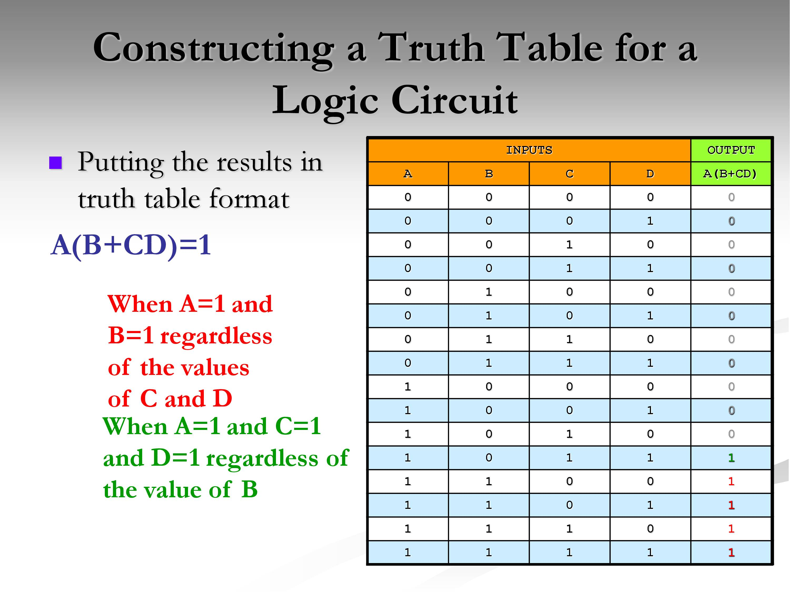
Putting the values in the Truth Table

Slide 22
Class work
Construct Truth tables for the following expressions
A’ +(BC)
(AB + C’)’
AC + B’C
(A+B’)C
AB(C+D)
ABC + ABD
A’B’C+BC+AB
A’BC+AB’C+ABC’+ABC

